Slide 1



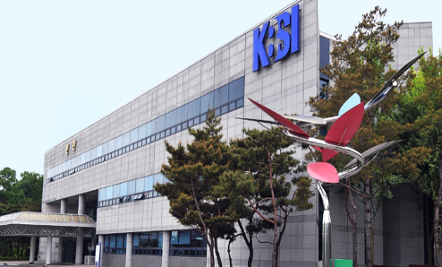


KUTC Publications/IPs
March 1, 2023
Khalifa University of Science and Technology
KU Director, Daniel Choi
https://www.ku.ac.ae/kutc
1

Slide 2
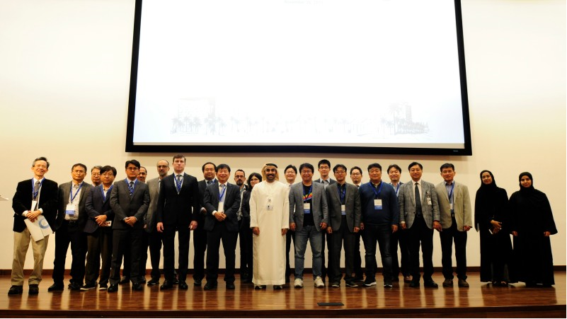
KUTC Joint Workshop (November 26, 2019) @ KU
Thematic Area: Advanced Materials
Semiconductor device/
characterization
Oil & Gas
Energy
Catalysts/
Health
7

Slide 3
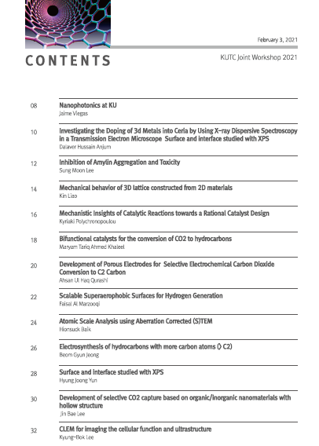
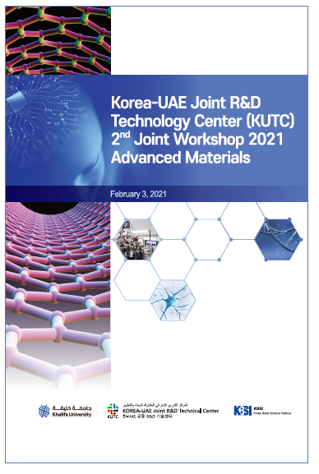
8

Slide 4
Joint Papers and IP
Papers
- Joint:
1. (From KUTC Project) A, Kanagaraj, P. Chaturvedi, H. Kim and D. Choi, “Controllable Synthesis of LiFePO₄ Microrods and
Its Superior Electrochemical Performance”, Materials Letters, 283, 128737, 2020.
2. (From KUTC Project) Alhammadi. A., Yun, H.J., Choi, “Investigation of LiFePO₄/MWCNT cathode-based half-cell lithium-ion
batteries in subzero temperature environments” Scientific reports. (Revision in progress, 2022).
3. (From KUTC Project) P. Chaturvedi, W. Hong, H. Kim and D. Choi, “Fabrication of flexible all solid-state Li-ion battery using thin,
flexible hybrid solid polymer electrolyte in ambient condition. (Manuscript in preparation, 2022)
3. Nitul S Rajput, Hionsuck Baik, Jin-You Lu, Srinivasa Reddy Tamalampudi, Raman Sankar, Amal Al Ghaferi, Matteo Chiesa
“Revealing the Quasi-Periodic Crystallographic Structure of Self-Assembled SnTiS₃ Misfit Compound”, The Journal of
Physical Chemistry C, 125, 9956, 2021.
4. I. Taha, N. Rajput, H. Baik, F. Ravaux, B. Alshaehhi, D. Choi, "Investigation on the interaction between GaN surface and H₂O
using a nanometer-scale GaN lamella structure", Journal of Physics D: Applied Physics, 53, 465103, 2020.
- KU only:
1. (From KUTC Project) P. Chaturvedi, A. Kanagaraj, A. Alhammadi, H. Alshibli and D. Choi, “Fabrication of PVDF-HFP
based microporous membranes by the tape-casting method as a separator for flexible Li-ion batteries”, Bulletin of Materials
Science, 44, 2, 161, 2021.
2. (From KUTC Project) P. Chaturvedi and D. Choi, “Fabrication of characterization of LTO-based CNT nanocomposites for
Li-ion battery, Ionics, 2022 (In review).
10

Slide 5
Joint Papers and IP
Daniel Choi, 7th November 2021
3. A. Lokhande, A. Shran, S. Nair, A. R. Shelke, V. C. Karade, J. H. Kim, N. Singh, D. Choi, “Self-supported graphene oxide encapsulated chalcopyrite electrode for high-performance Li-ion capacitor”, Journal of Energy Storage, 2022 (Accepted for publication).
4. A. Lokhande, D. Choi, “High performance Li-ion capacitor based on novel carbon-coated chalcogenide anode”, Journal of Energy Storage, 50, 104251, 2022.
5. A. Kanagaraj, P. Chaturvedi, Y. Kim, D. Choi, “Free-standing and flexible sulfur/MWCNT composite electrodes for Li-S batteries”, Materials Letters, 306, 130900, 2021.
IP
- Joint: None
- KU only:
(From KUTC Project) P. Chaturvedi, D. Choi “Li-ion battery based on solid electrolyte flexible membrane”. US Provisional Patent
application filed in September 2022, US 63/399,935
(From KUTC Project) P. Chaturvedi, D. Choi “A method of fabrication of PVDF-HFR based microporous membranes as
separator for Li-ion battery”. (Invention Disclosure in preparation)
10

